Slide 1
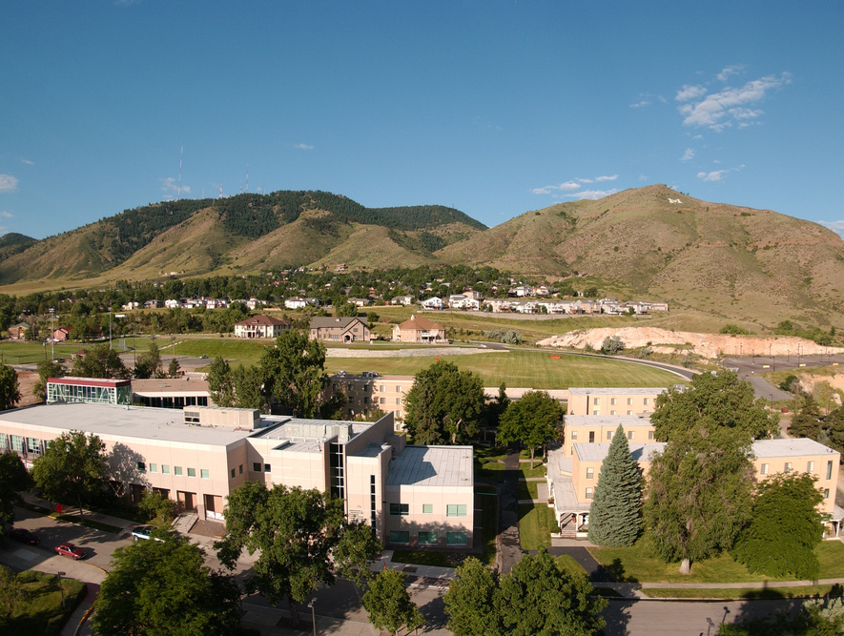
Colorado School of Mines
Computer Vision
Professor William Hoff
Dept of Computer Science
http://inside.mines.edu/~whoff/

Slide 2
Object Detection

Slide 3
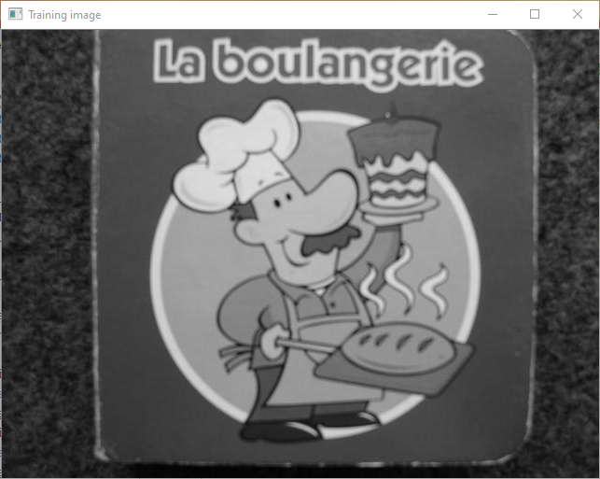
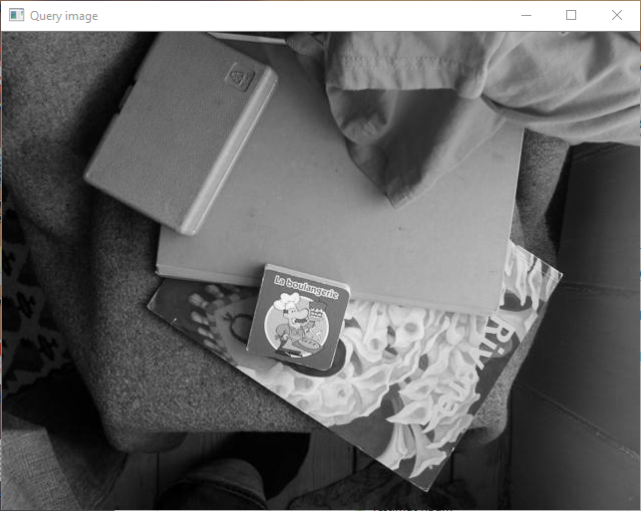
Object Detection
We have a “training image” of a specific object (e.g., the “La boulangerie” book)
We want to detect an instance of that object in a “query image”
Training image
Query image

Slide 4
Idea: Match features
Find features (e.g., SURF) in both images
Match features between images
Eliminate ambiguous matches (e.g., the ratio test)
Count matches
If there are enough matches, we have found the object!
Problem
If the object is present, a lot of matches are incorrect
If the object is not present, there are a lot of matches anyway

Slide 5
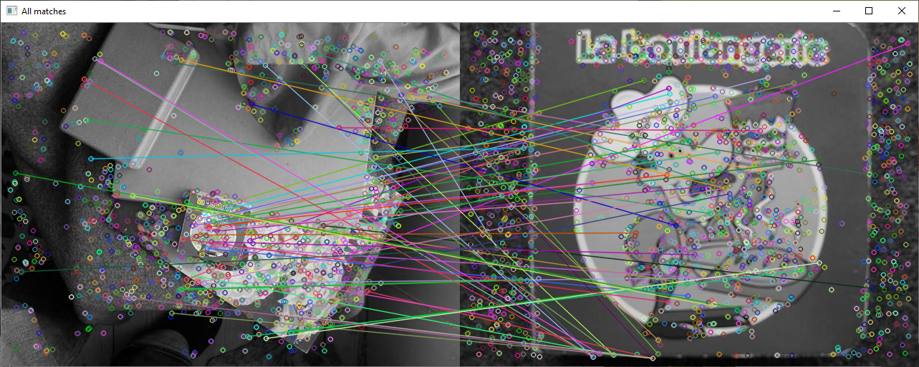
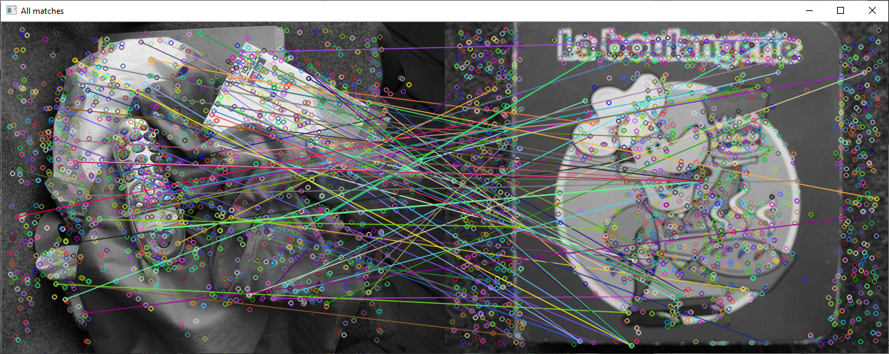
Query
Training
Object is present
Query
Training
Object not present

Slide 6
import os import cv2 import numpy as np IMAGE_DIRECTORY = "images" TRAINING_IMAGE_NAME = "book1.pgm" QUERY_IMAGE_NAME = "Img01.pgm" def main(): file_path = os.path.join(IMAGE_DIRECTORY, TRAINING_IMAGE_NAME) assert(os.path.exists(file_path)) bgr_train = cv2.imread(file_path) # Get training image file_path = os.path.join(IMAGE_DIRECTORY, QUERY_IMAGE_NAME) assert(os.path.exists(file_path)) bgr_query = cv2.imread(file_path) # Get query image # Show input images. cv2.imshow("Training image", bgr_train) cv2.imshow("Query image", bgr_query) # Extract keypoints and descriptors. kp_train, desc_train = detect_features(bgr_train, show_features=True) kp_query, desc_query = detect_features(bgr_query, show_features=False) matcher = cv2.BFMatcher.create(cv2.NORM_L2) # Match query image descriptors to the training image. # Use k nearest neighbor matching and apply ratio test. matches = matcher.knnMatch(desc_query, desc_train, k=2) good = [] for m, n in matches: if m.distance < 0.8 * n.distance: good.append(m) matches = good print("Number of raw matches between training and query: ", len(matches)) bgr_matches = cv2.drawMatches( img1 = bgr_query, keypoints1 = kp_query, img2 = bgr_train, keypoints2 = kp_train, matches1to2 = matches, matchesMask = None, outImg = None) cv2.imshow("All matches", bgr_matches) cv2.waitKey(0)
Program to detect and match features

Slide 7
def detect_features(bgr_img, show_features=False): detector = cv2.xfeatures2d.SURF_create( hessianThreshold=100, # default = 100 nOctaves=4, # default = 4 nOctaveLayers=3, # default = 3 extended=False, # default = False upright=False # default = False ) # Extract keypoints and descriptors from image. gray_image = cv2.cvtColor(bgr_img, cv2.COLOR_BGR2GRAY) keypoints, descriptors = detector.detectAndCompute(gray_image, mask=None) # Optionally draw detected keypoints. if show_features: # Possible flags: DRAW_MATCHES_FLAGS_DRAW_RICH_KEYPOINTS, DRAW_MATCHES_FLAGS_DEFAULT bgr_display = bgr_img.copy() cv2.drawKeypoints(image=bgr_display, keypoints=keypoints, outImage=bgr_display, flags=cv2.DRAW_MATCHES_FLAGS_DRAW_RICH_KEYPOINTS) cv2.imshow("Features", bgr_display) print("Number of keypoints: ", len(keypoints)) cv2.waitKey(0) return keypoints, descriptors
Function to detect features

Slide 8
Solution: Fit a transform
Fit a transformation to the feature matches
Find a transform such that many features fit the same transform
It is very unlikely that features will fit the same transform by accident
The features that fit the transform are likely to be correct
The object is detected if we have sufficient features that fit the transform

Slide 9
Possible transforms
2D image to 2D image transforms
Training data: 2D feature points from an image
Query data: 2D feature points from an image
Possible transforms are the homography transform, or the affine transform
Both are suitable if the object is mostly planar
3D data to 2D image transform
Training data: 3D feature points from a model
Query data: 2D feature points from an image
Use the perspective projection transform
Very general, but requires knowing 3D points on the object

Slide 10
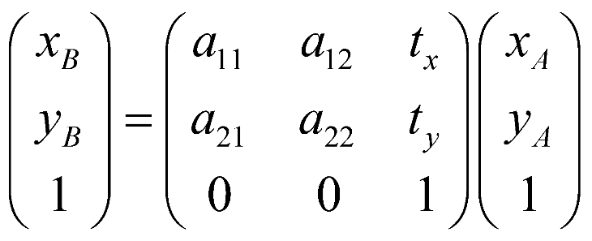
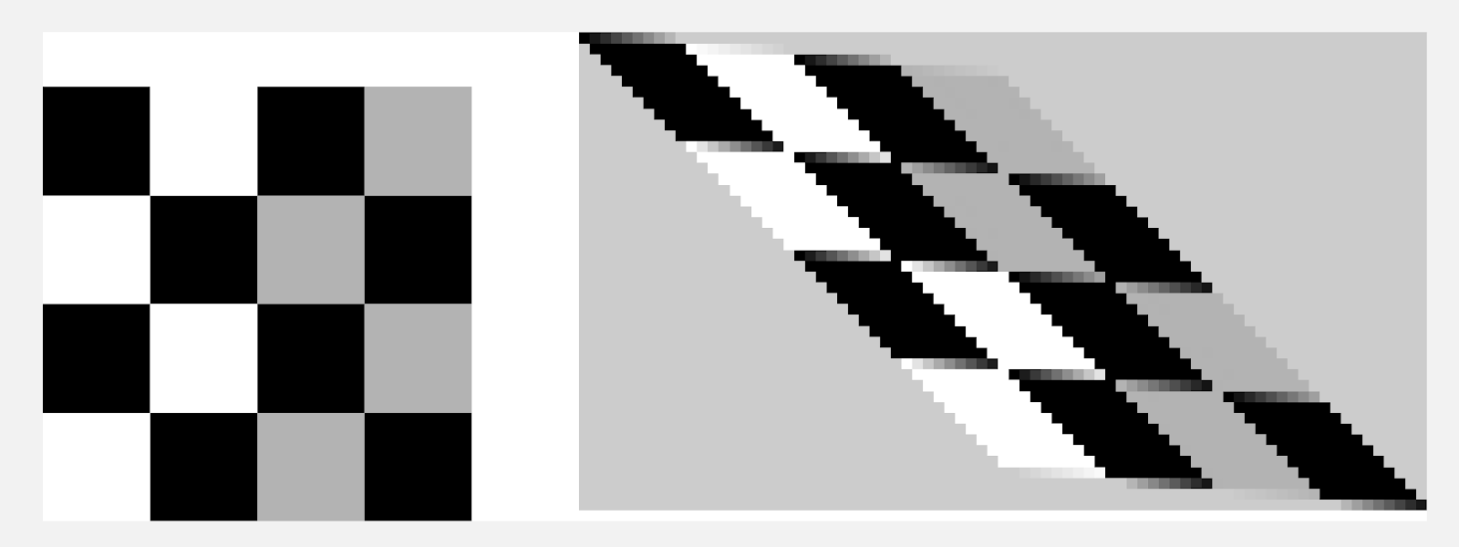
Affine transform
Assume we have training images, but not a 3D model
We’ll use the affine transform
Models rotation, translation, scaling, shearing, and reflection
Six degrees of freedom; requires a minimum of 3 point correspondences
Notes
It is an approximation for perspective projection of 3D objects
Works best for planar objects and small viewpoint changes

Slide 11
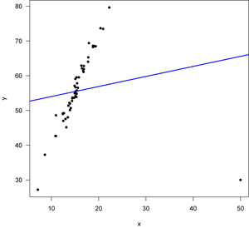
Outliers: a problem when fitting a transform
Least-squares fitting minimizes an objective function, which is the sum of squared errors
If there are outliers, they can have very large errors, so they “skew” the fitting
We need to get rid of outliers!

Slide 12
One Solution: Least Median of Squares (LMS)
“Median”: is the middle of a sorted list of numbers
LMS finds the solution that minimizes the median of the squared error, instead of the sum of the squared errors
Ignores large errors
Handles outliers up to 50%
outliers
Squared error
median

Slide 13
What if we have > 50% outliers?
We can create a set of matches that are probably correct, using a method called “pose clustering”
Idea
Each feature match “votes” for poses in the space of all possible poses
The pose with the highest number of votes probably has all inliers (or almost all inliers)
We can then fit a transform to this set of matches using LMS
These are probably mostly inliers so LMS will work

Slide 14
Pose Clustering
pc
The feature in the training image is located at p1
The vector to the “origin” of the training image is v1 = pc – p1 with respect to this feature
If we find a matching feature in the query image at p2
We can apply the same offset to its location, to determine where the origin of the object is in this image
However, we need to scale and rotate v1, using the relative scale and angle of the feature
Consistent matches should vote for
The same relative scale and angle
The same location of the object origin in the query image
v1
p1
v1
p2
v2
p2

Slide 15
Scale and Rotation
Given
(x1,y1,a1,s1) from image 1
(x2,y2,a2,s2) from image 2
Let
v1 = (cx-x1, cy-y1)^{T}
sr = s1/s2 % scale ratio
da = a1 – a2 % difference in angles
Then
v2 = R*(v1/sr)
where R is the rotation matrix
pc
v1
p1
v2
p2

Slide 16
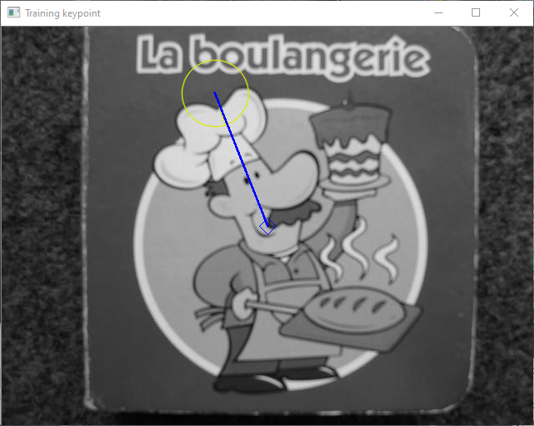
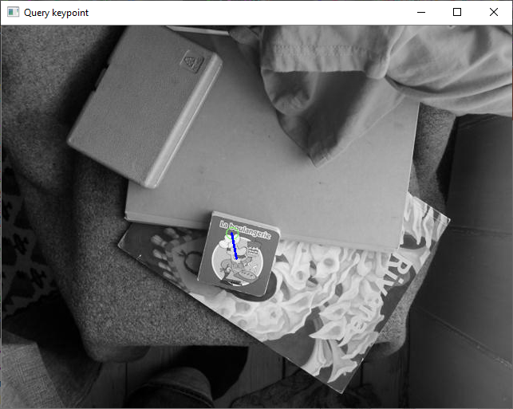
Example
Demo – feature matching and show votes

Slide 17
def show_votes(query_img, keypoints_query, train_img, keypoints_train, matches): # Create zero image. hq = query_img.shape[0] wq = query_img.shape[1] votes_img = np.zeros((hq,wq), dtype=np.uint8) ht = train_img.shape[0] wt = train_img.shape[1] # Vote into accumulator array. for match in matches: qi = match.queryIdx # Index of query keypoint ti = match.trainIdx # Index of training keypoint that matched # Get data for training image. kp_train = keypoints_train[ti] at = kp_train.angle st = kp_train.size pt = np.array(kp_train.pt) # training keypoint location mt = np.array([wt/2, ht/2]) # Center of training image vt = mt - pt # Vector from keypoint to center # Display training image. train_img_display = train_img.copy() cv2.drawKeypoints(image=train_img_display, keypoints=[kp_train], outImage=train_img_display, flags=cv2.DRAW_MATCHES_FLAGS_DRAW_RICH_KEYPOINTS) cv2.drawMarker(img=train_img_display, position=(int(mt[0]), int(mt[1])), color=(255, 0, 0), markerType=cv2.MARKER_DIAMOND) cv2.line(img=train_img_display, pt1=(int(pt[0]), int(pt[1])), pt2=(int(mt[0]), int(mt[1])), color=(255,0,0), thickness=2) cv2.imshow("Training keypoint", train_img_display)
Function to show votes (1 of 2)

Slide 18
# Get data for query image. kp_query = keypoints_query[qi] aq = kp_query.angle sq = kp_query.size pq = np.array(kp_query.pt) # Rotate and scale the vector to the marker point. scale_factor = sq / st angle_diff = aq - at vq = rotate_and_scale(vt, scale_factor, angle_diff) mq = pq + vq # Display query image. query_img_display = query_img.copy() cv2.drawKeypoints(image=query_img_display, keypoints=[kp_query], outImage=query_img_display, flags=cv2.DRAW_MATCHES_FLAGS_DRAW_RICH_KEYPOINTS) cv2.line(img=query_img_display, pt1=(int(pq[0]), int(pq[1])), pt2=(int(mq[0]), int(mq[1])), color=(255,0,0), thickness=2) cv2.imshow("Query keypoint", query_img_display) cv2.waitKey(0) a_row = int(mq[1]) a_col = int(mq[0]) if a_row >= 0 and a_row < hq and a_col >= 0 and a_col < wq: votes_img[a_row, a_col] += 1 # Display the vote image. cv2.namedWindow("Votes image", cv2.WINDOW_NORMAL) # Scale (for display purposes only). Min value is set to alpha, max value to beta. votes_display = cv2.normalize( src = votes_img, dst = None, alpha = 0, beta = 255, norm_type = cv2.NORM_MINMAX, dtype = cv2.CV_8U) cv2.imshow("Votes image", votes_display) cv2.waitKey(0)
Function to show votes (2 of 2)

Slide 19
Function to rotate and scale a vector
def rotate_and_scale(vt, scale_factor, angle_diff): theta = np.radians(angle_diff) c, s = np.cos(theta), np.sin(theta) R = np.array(((c, -s), (s, c))) vq = R @ vt vq = vq * scale_factor return vq

Slide 20
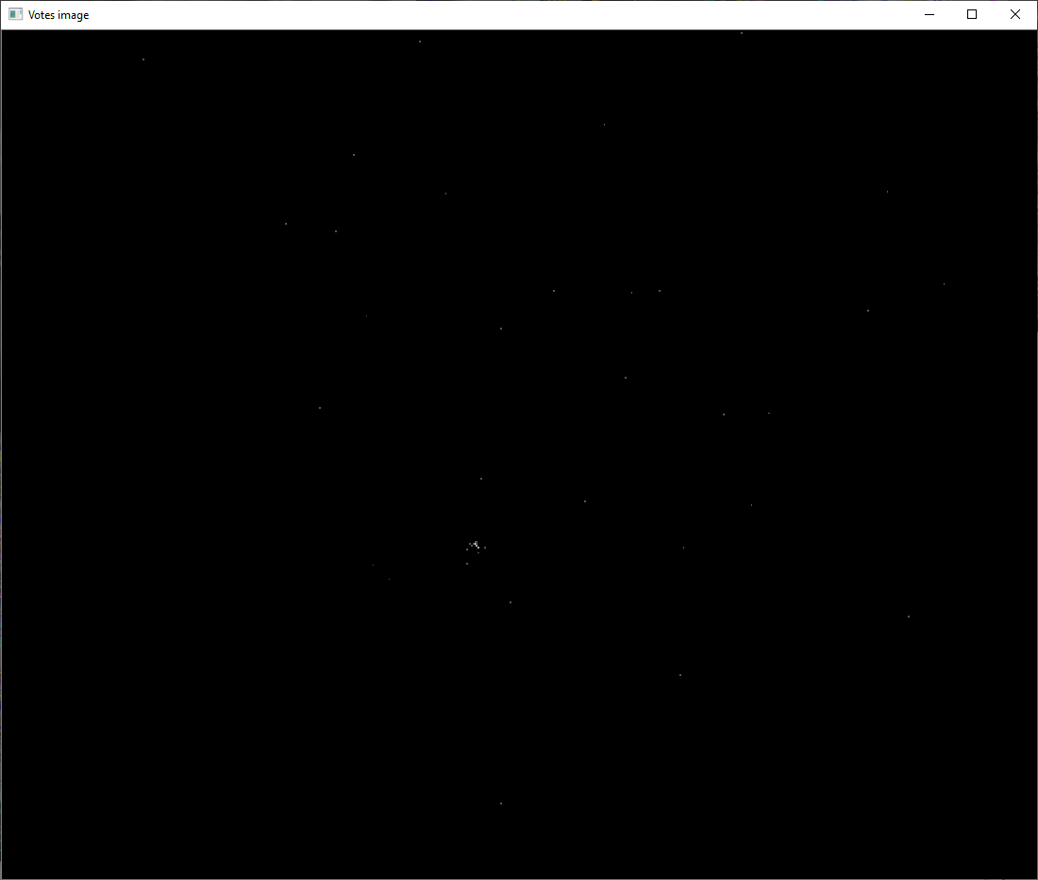
Votes image

Slide 21
Clustering
Use a quantized pose space
Dimensions are (angle,scale,x,y)
Have coarse bins
Angles are 0..360, divided into 8 bins
Scales are 0..4, divided into 5 bins
x is 0..image_width, divided into 5 bins
y is 0..image_height, divided into 5 bins
Use coarse bins because
Fast
Transformation is only approximate anyway

Slide 22
# Given the proposed matches, each match votes into a quantized "pose" space. Find the # bin with the largest number of votes, and return the matches within that bin. def find_cluster(query_img, keypoints_query, train_img, keypoints_train, matches): hq = query_img.shape[0] wq = query_img.shape[1] max_scale = 4.0 # Scale differences go from 0 to max_scale # Our accumulator array is a 4D array of empty lists. These are the number of bins # for each of the dimensions. num_bins_height = 5 num_bins_width = 5 num_bins_scale = 5 num_bins_ang = 8 # It is easier to have a 1 dimensional array instead of a 4 dimensional array. # Just convert subscripts (h,w,s,a) to indices idx. size_acc = num_bins_height * num_bins_width * num_bins_scale * num_bins_ang acc_array = [[] for idx in range(size_acc)] ht = train_img.shape[0] wt = train_img.shape[1] # Vote into accumulator array. for match in matches: qi = match.queryIdx # Index of query keypoint ti = match.trainIdx # Index of training keypoint that matched # Get data for training image. kp_train = keypoints_train[ti] at = kp_train.angle st = kp_train.size pt = np.array(kp_train.pt) # training keypoint location mt = np.array([wt / 2, ht / 2]) # Center of training image vt = mt - pt # Vector from keypoint to center # Get data for query image. kp_query = keypoints_query[qi] aq = kp_query.angle sq = kp_query.size pq = np.array(kp_query.pt)
Function to find bin with largest cluster of matches (1 of 2)

Slide 23
# Rotate and scale the vector to the marker point. scale_factor = sq / st angle_diff = aq - at angle_diff = (angle_diff + 360) % 360 # Force angle to between 0..360 degrees vq = rotate_and_scale(vt, scale_factor, angle_diff) mq = pq + vq # Compute the cell of the accumulator array, that this match should be stored in. row_subscript = int(round(num_bins_height * (mq[1] / hq))) col_subscript = int(round(num_bins_width * (mq[0] / wq))) if row_subscript >= 0 and row_subscript < num_bins_height and col_subscript >= 0 and col_subscript < num_bins_width: scale_subscript = int(num_bins_scale * (scale_factor / max_scale)) if scale_subscript > num_bins_scale: scale_subscript = num_bins_scale - 1 ang_subscript = int(num_bins_ang * (angle_diff / 360)) # print(row_subscript,col_subscript, scale_subscript, ang_subscript) # Note: the numpy functions ravel_multi_index(), and unravel_index() convert # subscripts to indices, and vice versa. idx = np.ravel_multi_index( (row_subscript, col_subscript, scale_subscript, ang_subscript), (num_bins_height, num_bins_width, num_bins_scale, num_bins_ang)) acc_array[idx].append(match) # Count matches in each bin. counts = [len(acc_array[idx]) for idx in range(size_acc)] # Find the bin with maximum number of counts. idx_max = np.argmax(np.array(counts)) # Return the matches in the largest bin. return acc_array[idx_max]
Function to find bin with largest cluster of matches (2 of 2)

Slide 24
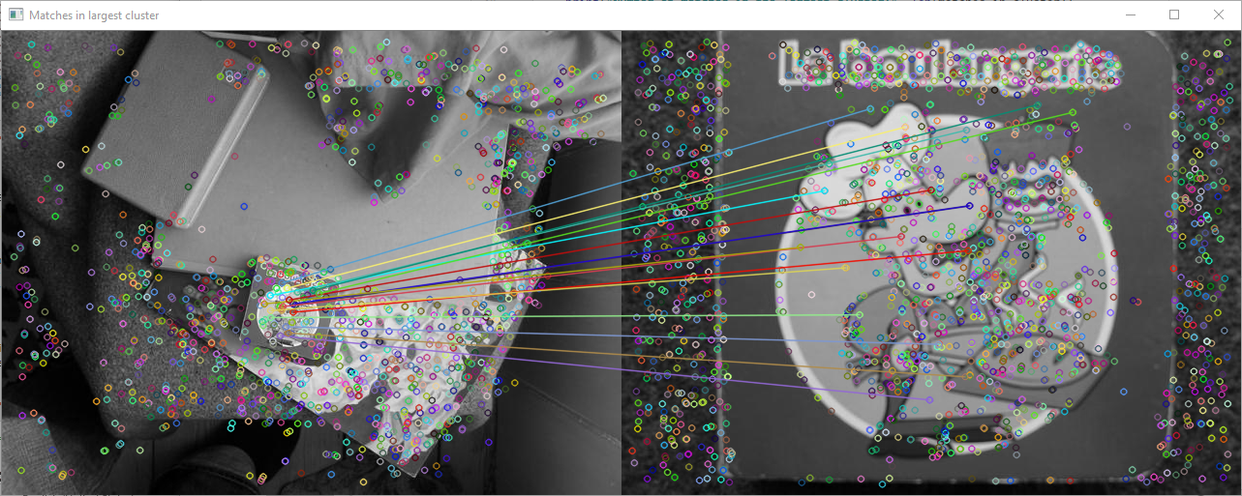
Number of raw matches between training and query: 63
Number of matches in the largest cluster: 17

Slide 25
Affine Transform
Finally, fit a 2D affine transformation to the set of potentially correct matches (≥3)
Use Least Median of Squares to handle any remaining outlier matches
OpenCV’s “estimateAffine2D” function
Fits affine transform to matches
Returns: Affine transform matrix, and list of inliers
Outliers are matches that have a large error relative to the median of errors

Slide 26
Function to compute an affine transform from training image to query image
# Calculate an affine transformation from the training image to the query image. def calc_affine_transformation(matches_in_cluster, kp_train, kp_query): if len(matches_in_cluster) < 3: print("Not enough matches to calculate affine transformation; object not detected.") return None, None # Estimate affine transformation from training to query image points. # Use the "least median of squares" method for robustness. src_pts = np.float32([kp_train[m.trainIdx].pt for m in matches_in_cluster]).reshape( -1, 1, 2) dst_pts = np.float32([kp_query[m.queryIdx].pt for m in matches_in_cluster]).reshape( -1, 1, 2) A_train_query, inliers = cv2.estimateAffine2D( src_pts, dst_pts, method=cv2.LMEDS) return A_train_query, inliers

Slide 27
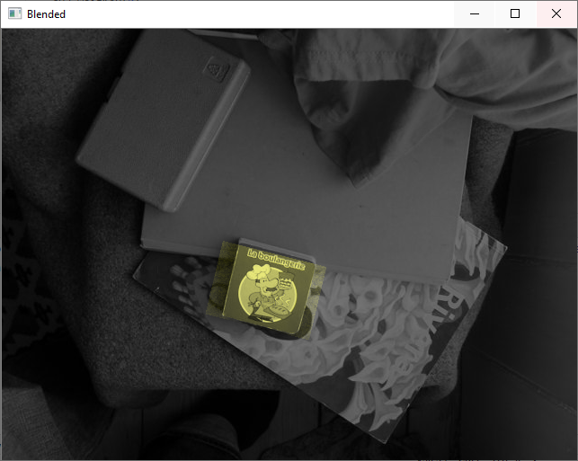
Apply affine transform to image
Warp the training image and blend with the query image

